Slide 1
Smart Manufacturing – Fuel Efficiency & Turbine Health Analytics
Team:
Naveenkumar R
Vinesh SR
Sai Rohith
Abinaya Sri
Sujan SK

Slide 2
Outline
Problem Statement
Objective
Microservices
System Design and Architecture
Data Analysis
Azure Integration
API
Testing & Release Readiness

Slide 3

Problem Statement
Modern manufacturing and shipping industries generate huge volumes of turbine telemetry data (torque, pressure, fuel flow, decay coefficients).
This data is often siloed, making it hard to:
* Monitor turbine health in real time
* Detect anomalies early
* Optimize fuel efficiency
This results in downtime, inefficiency, and higher costs. A cloud-native analytics platform is needed to centralize data, process it, and provide actionable KPIs and alerts. .

Slide 4
Objective
Build a cloud-native turbine health analytics platform that can:
Ingest & clean turbine telemetry data from CSV logs
Transform & compute KPIs (fuel efficiency, torque differential, decay coefficients)
Visualize trends and insights using Matplotlib & Seaborn
Build modular ETL pipelines that clean, transform, and store telemetry data
Detect anomalies and generate alerts
Expose REST APIs for real-time health summaries

Slide 5
Microservices
Data Ingestion Module
Data Cleaning & Transformation Module
KPI Computation Module
REST API Module (FastAPI)
Visualization Module
Anomaly Detection Module

Slide 6
SYSTEM MODELS & ARCHITECTURE DIAGRAMS
UML USE CASE DIAGRAM
UML COMPONENT DIGARAM
UML DEPLOYMENT DIAGRAM

Slide 7
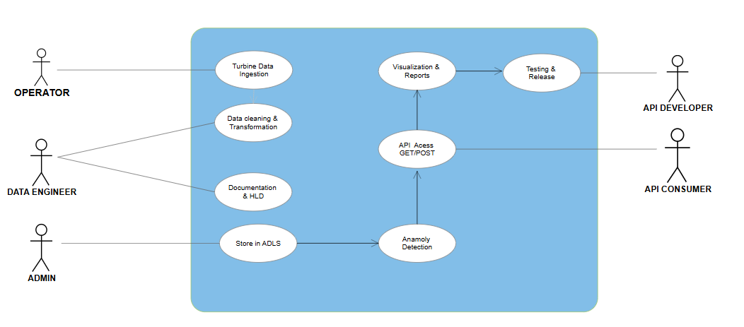
UML USE CASE DIAGRAM
Captures the functional requirements of the system from the operator’s perspective. It explains what the system does (use cases like anomaly detection, KPI monitoring, and alert generation) without going into technical details.

Slide 8
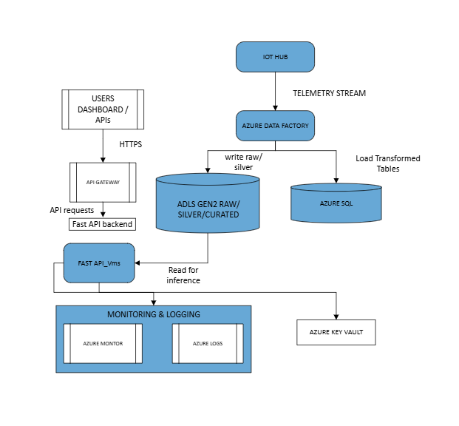
Shows how the system is deployed on Azure cloud and Databricks clusters & maps logical components to the actual infrastructure for scalability and performance.
UML DEPLOYMENT DIAGRAM

Slide 9
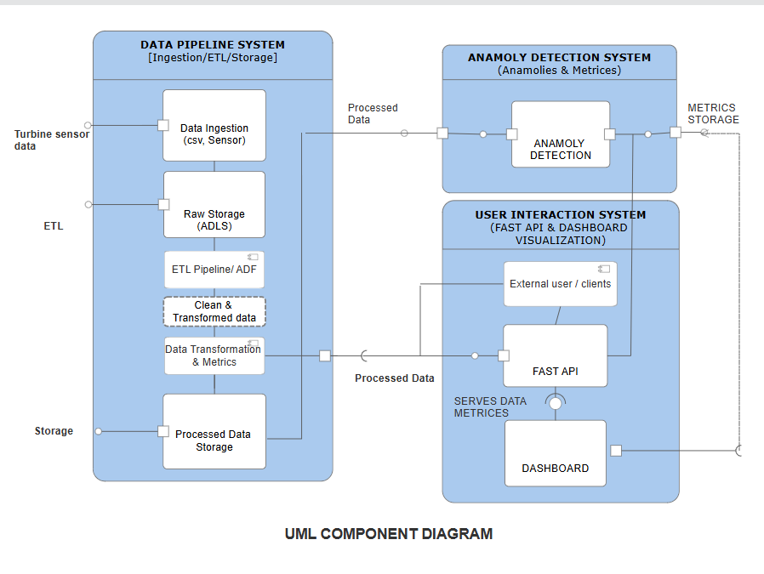
UML COMPONENT DIAGRAM
Represents how different modules (APIs, data pipelines, monitoring services) are organized and interact.

Slide 10
HIGH LEVEL DESIGN

Slide 11
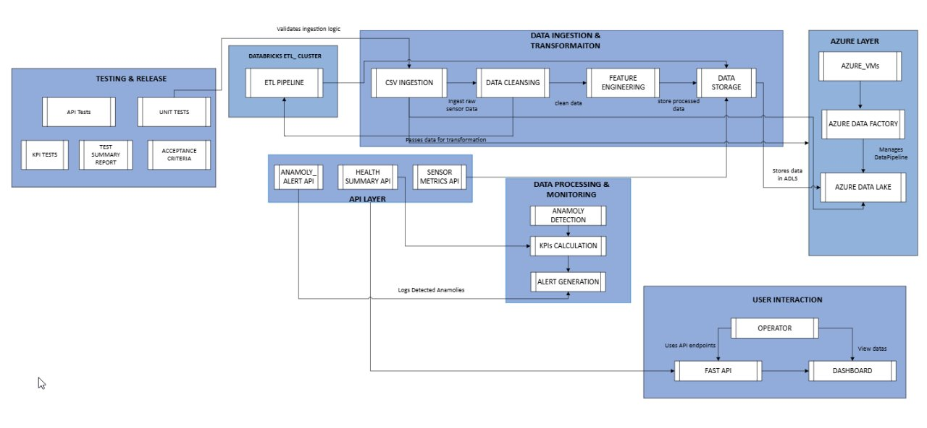
HIGH LEVEL DESIGN
Provides an end-to-end view of the system, showing how data flows across ingestion, processing, monitoring, and user interaction.

Slide 12
EXPLORATORY DATA ANALYSIS
VISUALIZATON UISNG MATPLOTLIB / SEABORN​

Slide 13
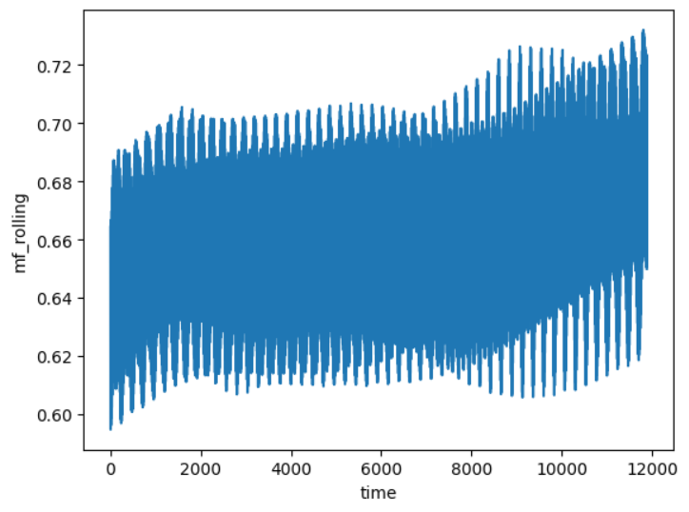
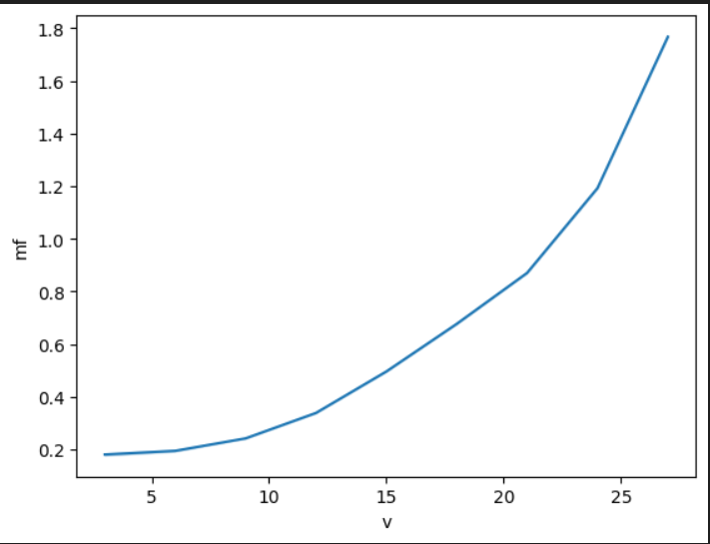
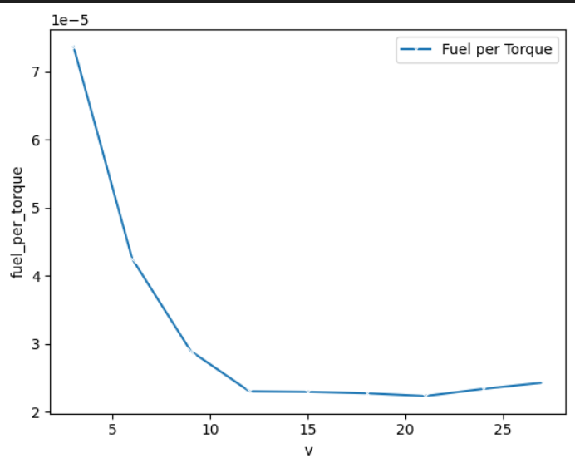
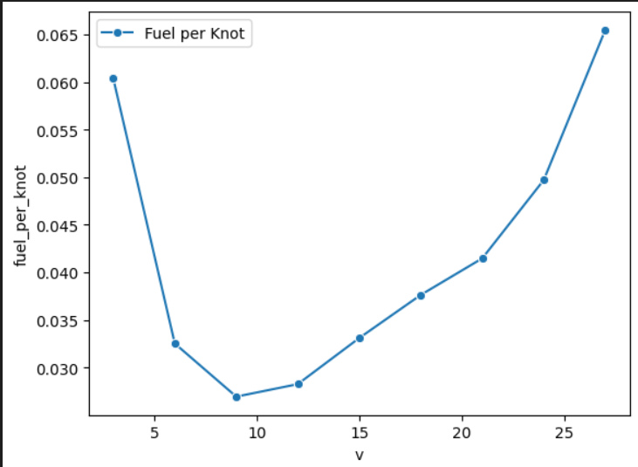
Line Plot for Data Interpretation

Slide 14
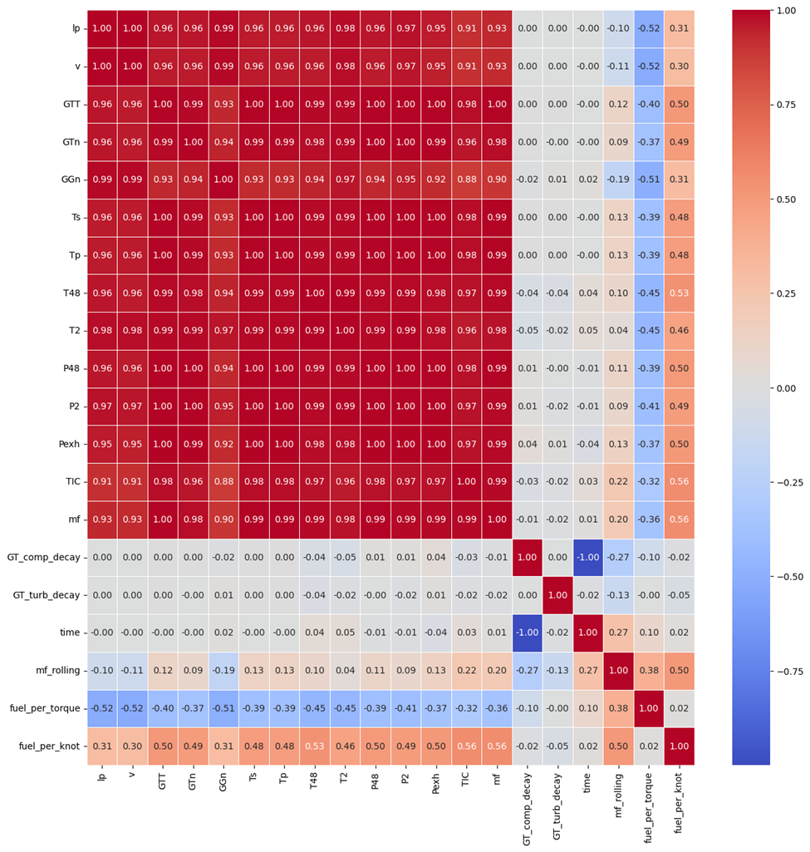
Heat Map of Correlation matrix

Slide 15
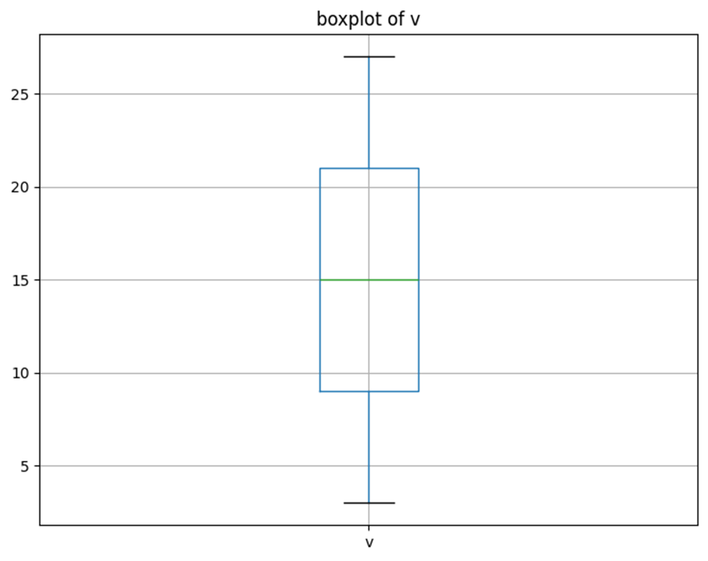
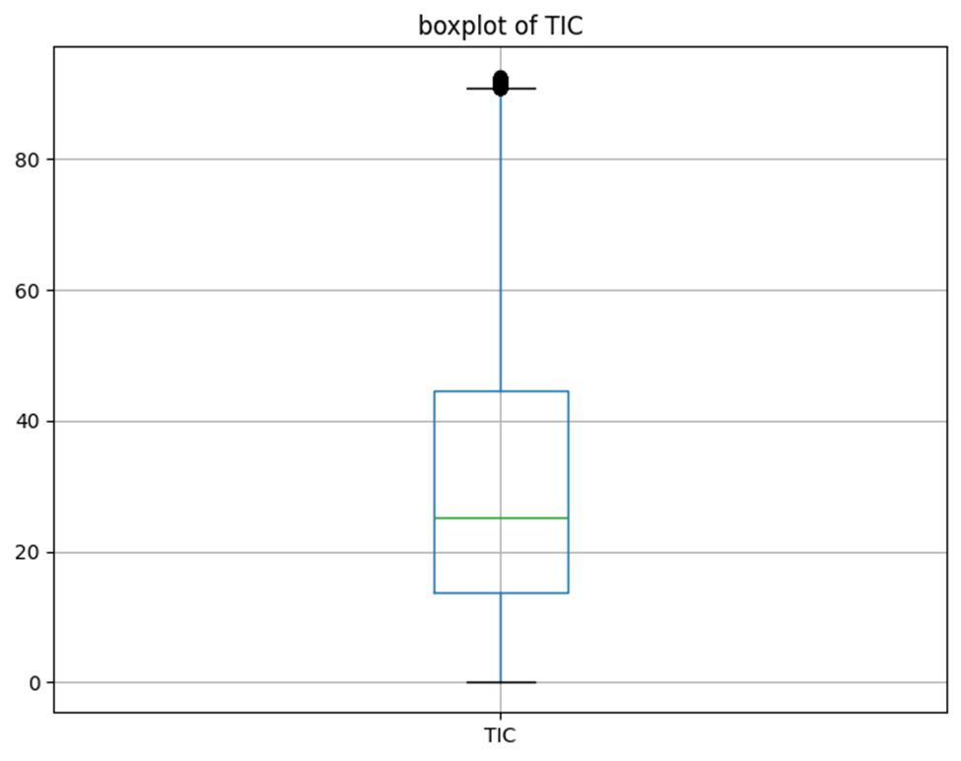
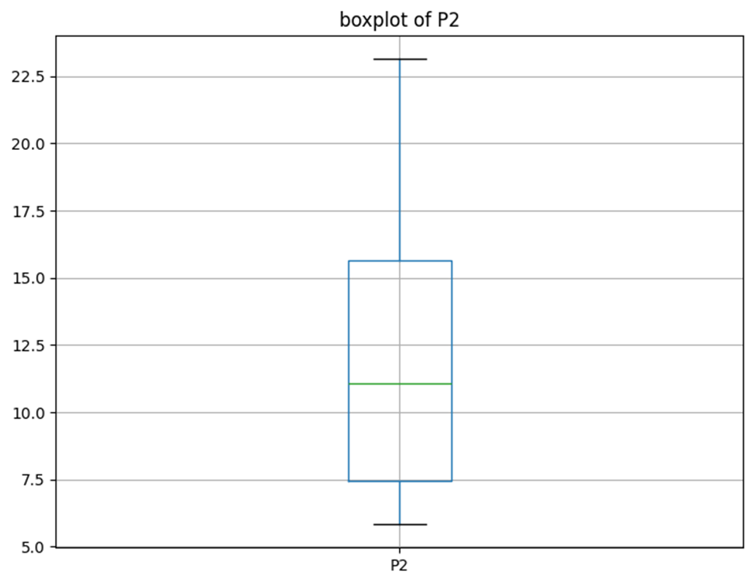
Box Plot for Outliers Detection

Slide 16
ETL & AZURE INTEGRATION

Slide 17
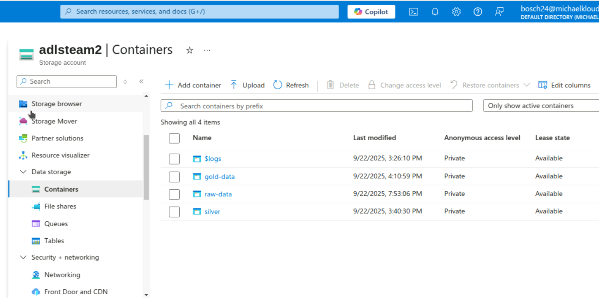
CREATING ADLS STORAGE ACCOUNT & CONTAINERS
Created ADLS containers for Raw (Bronze), Silver, and Gold layers to organize turbine data into ingestion, processed, and analytics-ready zones with proper access controls

Slide 18
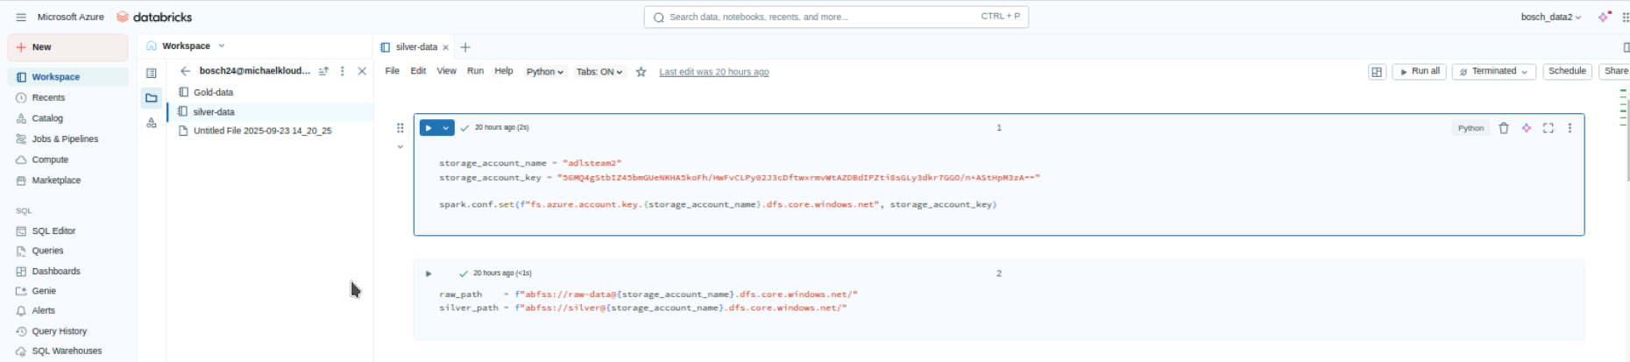
DATABRICKS CLUSTER
Configured secure authentication in Databricks notebooks to access ADLS Silver and Gold containers using Azure Service Principal and Key Vault.

Slide 19
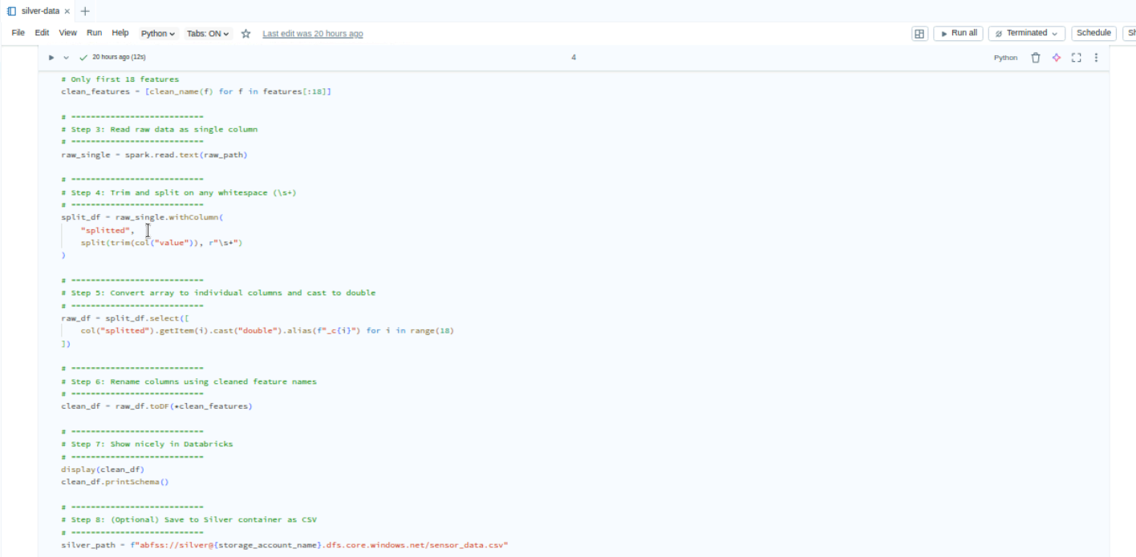
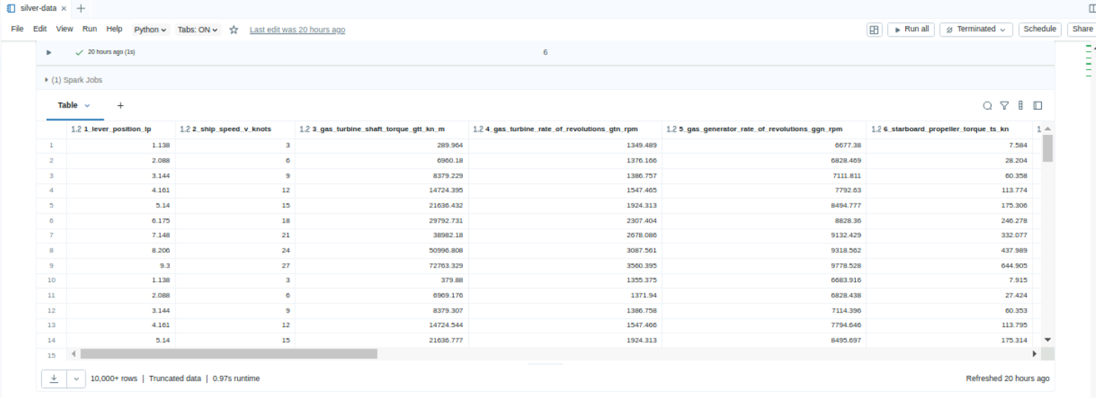
PROCESSING & TRANSFORMAITON - DATA BRICKS NOTEBOOK
DATA CLEANSING & PROCESSING USING SILVER LAYER

Slide 20
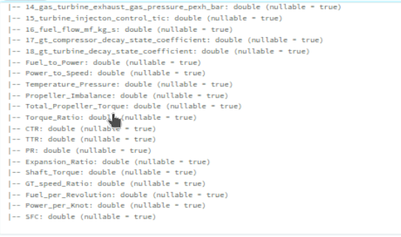
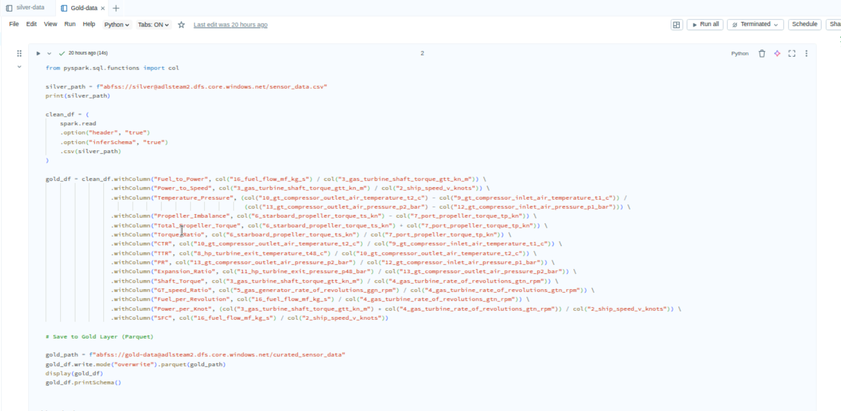
Gold Layer: Analytics-Ready Data Storage
Stored curated and business-ready data in the Gold layer for advanced analytics, KPI computation, and anomaly detection

Slide 21
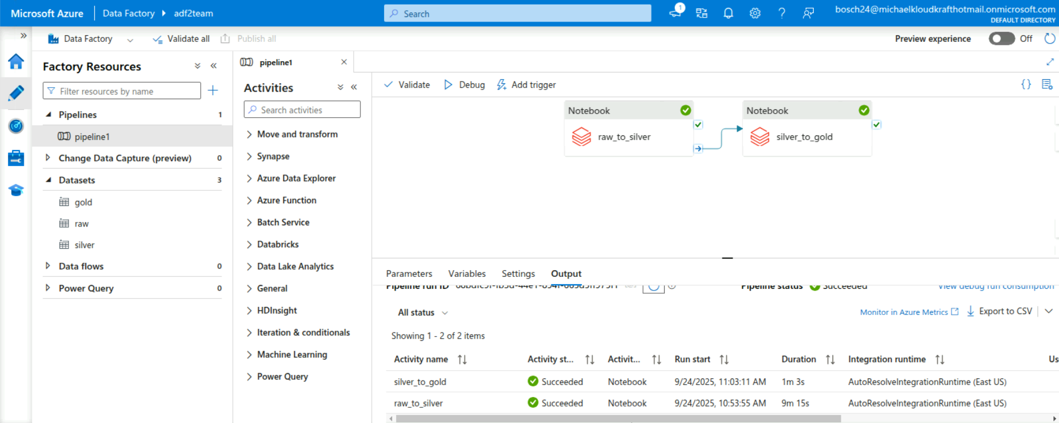
ADF PIPELINE CREATED AND PUBLISHED
Designed, validated, and published the ETL pipeline in Azure Data Factory to move data from
Bronze → Silver → Gold

Slide 22
FAST API
GET /health-summary – aggregate fuel usage
GET /sensor-metrics – recent telemetry for a turbine.
POST /anomaly-alerts – log new anomaly detection.

Slide 23
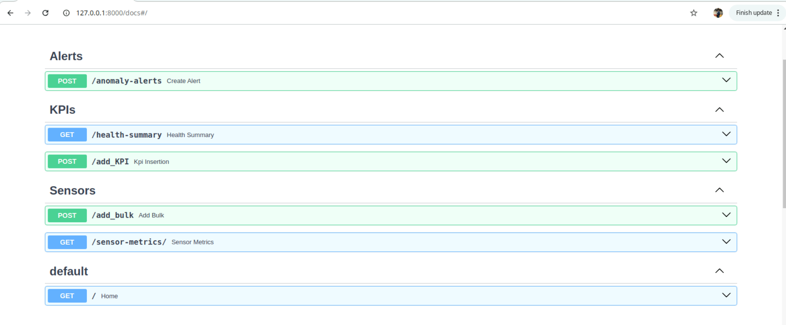
GET/POST for KPIs & Anomaly Alerts
Implemented REST APIs using FastAPI to expose KPI metrics and send anomaly alerts to dashboards and monitoring tools

Slide 24
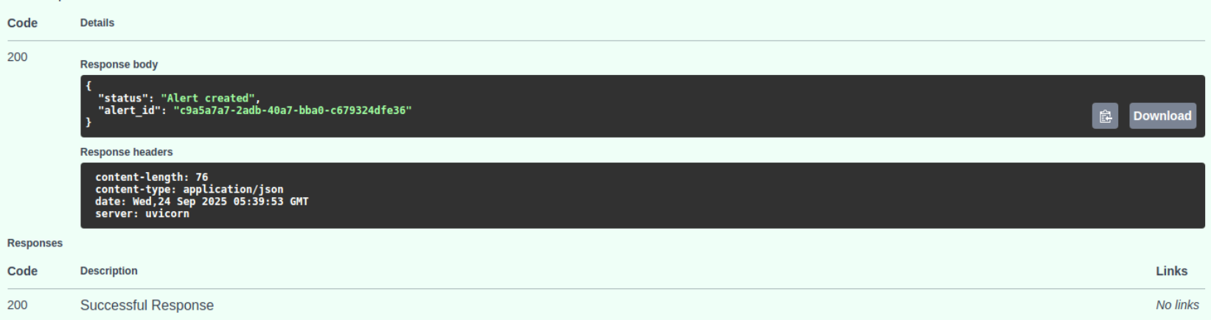
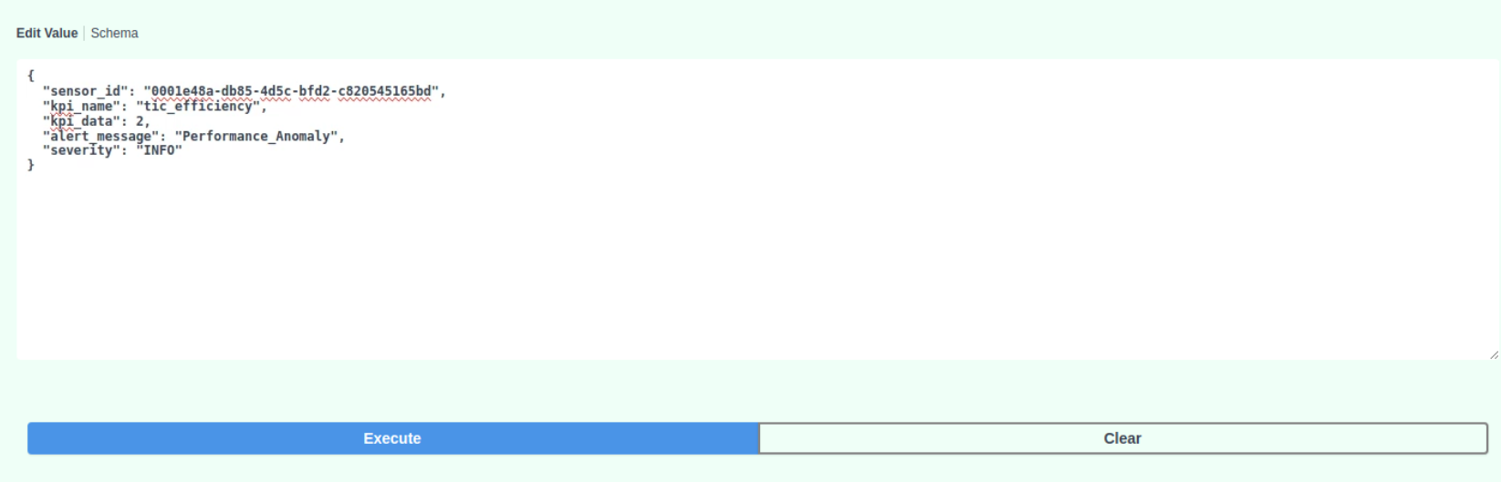
POST API: Submit Anomaly Data
Request output
Anamoly post request

Slide 25
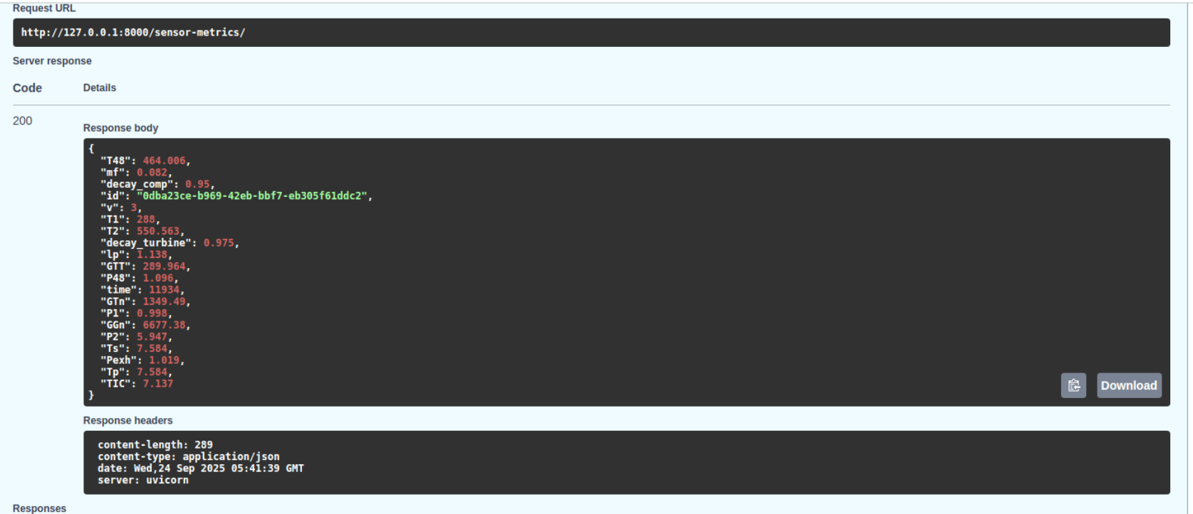
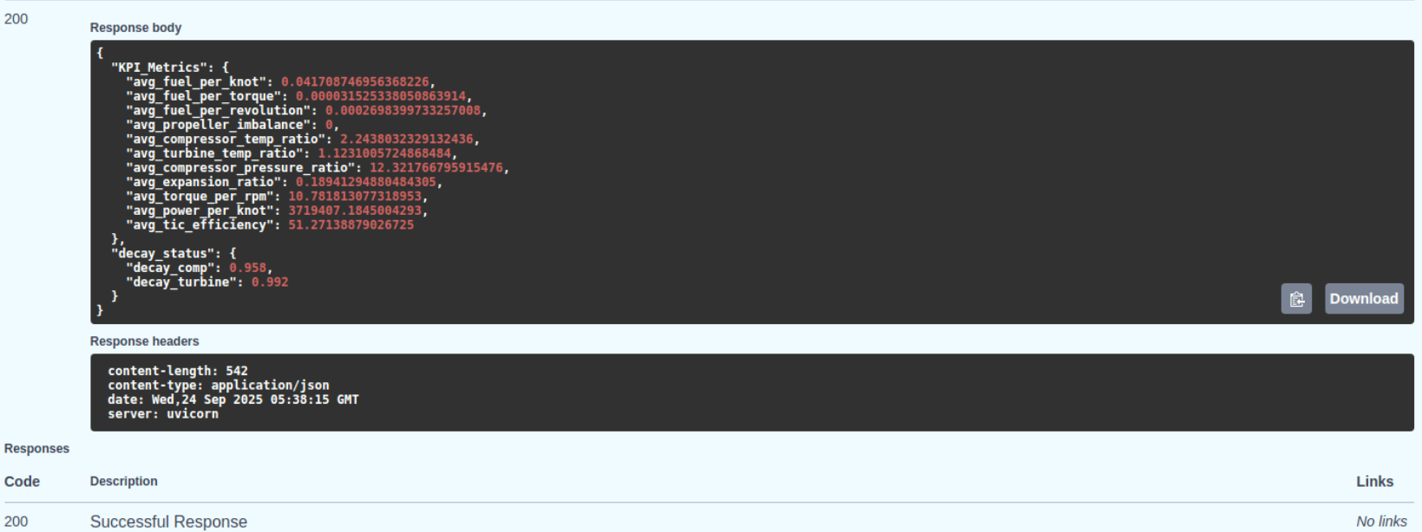
GET API: Retrieve Sensor Metrics and KPI

Slide 26
TESTING & READINESS

Slide 27
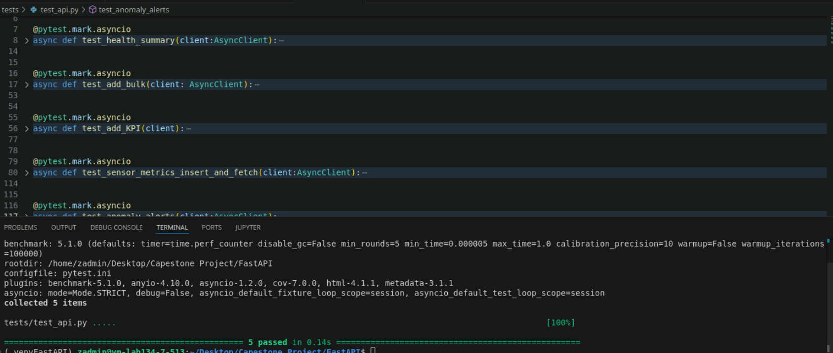
API Endpoint test

Slide 28
TURBINE HEALTH PLATFORM testing.pdf Test_Case_Summary_report_team2.xlsx

Slide 29






Technologies and Tools Used

Slide 30
Conclusion
Centralized turbine telemetry data in Azure Data Lake.
Built modular ETL pipelines for data ingestion, cleaning, and transformation.
Computed KPIs like fuel efficiency and decay coefficients.
Developed FastAPI endpoints for real-time health summaries & alerts.
Performed EDA & visualization using Matplotlib and Seaborn.
Enabled anomaly detection for proactive maintenance

Slide 31
Thank You

Slide 32


